Slide 1
Lending Where Trust are Involved

Slide 2
Agenda
Definition & Type of Trusts
01
Can You Lend to a Trust?
05
1.1 Unit Trust
1.2 Discretionary Trust
1.3 Hybrid Trusts
Five Key Issue to Consider When Lending to a Trustee:
5.1 The Trustee’s Right of Indemnity
5.2 ABN vs ACN
5.3 Removal of a Trustee
5.4 Serviceability Assessment
5.5 Lender Fees
Creating a Trust
02
Trust Powers
03
Conclusions
06
Legal Capacity
04

Slide 3
01
Definition & Type of Trusts

Slide 4
01 | Definition & Type of Trusts
A trust is money or property managed by a trustee for the benefit of beneficiaries.
Trusts can separate property management from its enjoyment, useful for children, elderly, or handicapped individuals.
Deceased estates and superannuation schemes often operate as trusts.
Trusts can serve charitable purposes, e.g., Variety Australia.

Slide 5
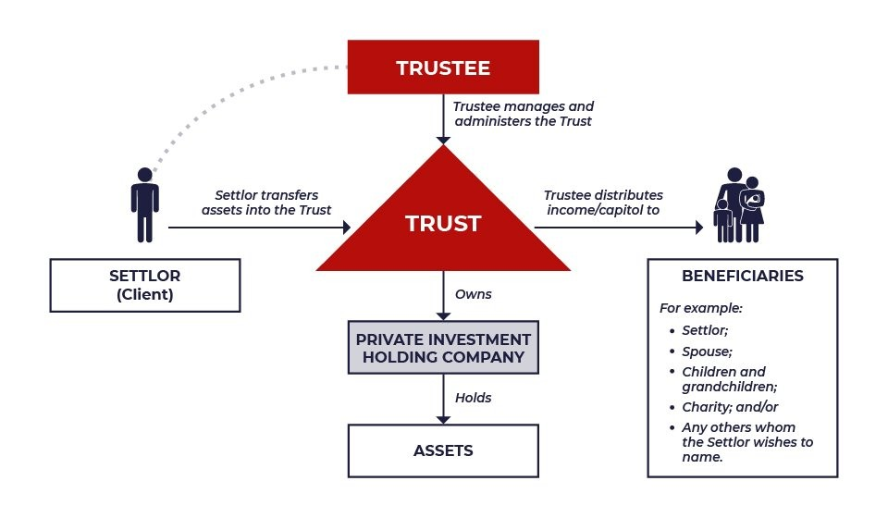

Slide 6
01 | Type of Trusts
There are different types of trust, the most common being:
Unit Trust
Discretionary Trust
Hybrid Trusts
(comparatively rare)
Where the beneficiaries are the unit holders, whose ownership of units determines the proportionate interest each has in the distribution of income and capital.
Where the interests of the beneficiaries are not fixed in any specific proportions by the trust deed. The trustee is given the discretion to determine the amount, timing and beneficiaries of any income or capital distribution.
A hybrid trust is both a discretionary and a unit trust. A certain portion of the trust property must be applied to the unit holders, with the trustee having a discretion as to the application of the balance.

Slide 7
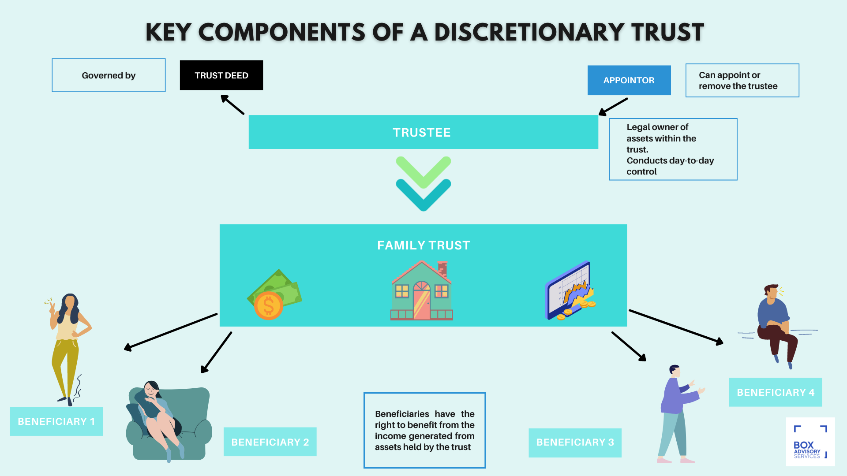
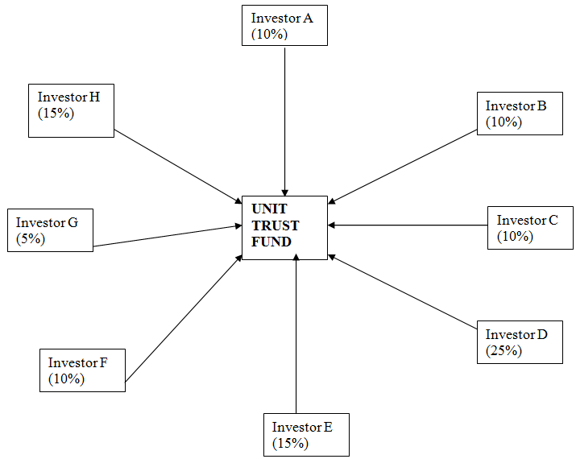
01 | Type of Trusts
There are different types of trust, the most common being:
Unit Trust
Discretionary Trust
Hybrid Trusts
(comparatively rare)

Slide 8
02
Creating a Trust

Slide 9
02 | Creating a Trust
A settlor transfers assets to a trustee for a specific purpose and beneficiaries.
The trust can accumulate its own funds after the initial settlement.
Beneficiaries have an equitable interest in the trust fund.
Some beneficiaries may be unknown at the time of trust creation.

Slide 10
03
Trust Powers

Slide 11
03 | Trust Powers
Trustee manages the trust per the Settlor's wishes as specified in the trust deed.
Trustee's powers are defined by the trust deed.
Trustee's powers are also governed by relevant State legislation (e.g., Trustees Act, 1925 in NSW).
Trustee's management and administration of the trust fund are limited to these powers.

Slide 12
04
Legal Capacity

Slide 13
04 | Legal Capacity
A trust is not a legal entity; liabilities are incurred in the trustee's name.
Trustees contract for the trust's benefit, and can be indemnified from trust assets.
Lenders typically require guarantees from trustees personally or from directors of trustee companies.
Beneficiaries aren't liable for trust liabilities; new trustees aren't liable for prior trustee debts.

Slide 14
05
Can You Lend to a Trust?

Slide 15
05 | Can You Lend to a Trust
Lenders finance trustees directly, not trusts.
The borrower is identified without reference to trustee capacity (e.g., ABC Limited).
Loan contracts clarify trustee liability personally and as trustee for the trust, ensuring access to trust assets.

Slide 16
Five key issues to consider when lending to a trustee:
1
2
The trustee’s right of indemnity
ABN v. ACN
Trustee is personally liable but usually indemnified from trust assets, except for fraud or negligence.
Lenders rely on the trustee’s indemnity right for recourse to trust assets.
Trustee must have powers under the trust terms to be indemnified.
Without indemnity, lenders may become unsecured creditors of the trustee.
ACNs uniquely identify companies; introduced to the Corporations Act.
ABNs introduced with GST in 2000; often ACN plus a two-digit prefix.
Companies can have multiple ABNs, especially as trustees of trusts.
Using an ABN in legal documents might unintentionally limit the agreement.

Slide 17
Five key issues to consider when lending to a trustee:
3
4
Removal of a trustee
Serviceability Assessment
Trust deeds regulate the removal of trustees.
Trustees may be automatically removed if found of unsound mind, bankrupt, or if a company, in liquidation or receivership.
Automatic removal of trustees upon enforcement of security can delay lender actions.
Recommend amending trust deeds to ensure replacement trustees are appointed automatically.
Loan serviceability for asset-holding trusts without income is assessed as if the trustee were applying personally.
If relying on trust income, the most recent 2-3 years' accounts are required.
Provide details on income type, source, permanence, and control over distribution.
Assess both trust and trustee income/commitments, and consult the lender for proper analysis.

Slide 18
Five key issues to consider when lending to a trustee:
5
Lender fees
Loans involving trusts are complex and require more documentation, leading to higher fees.
Standard Application Fee may not cover lender legal fees; confirm fees with the lender before quoting to the client.
Trustee must execute a guarantee, often requiring an independent legal advisor.
Independent legal advice adds additional cost to the borrower.

Slide 19
06
Conclusion

Slide 20
06 | Conclusion
Ensure the trust has the power to enter into the transaction and the borrower is bound personally and as trustee.
Use ACNs, not ABNs, in legal contracts.
Trust deed should not allow automatic removal of the trustee without a replacement.
Loans involving trusts require more documentation and assistance; contact the Compliance team if unsure.

Slide 21
Thank you!

