Slide 1
Brand New Clients
You receive a call from a gentlemen called Jonathan Kennedy who is seeking finance to purchase their first family home.
Jonathan is a full time PAYG electrician earning $150,000 per year.
His wife Caroline is a full time teacher PAYG earning $120,000 per year.
They have two kids ages 8 and 10 with $270,000 saved for a deposit.
Jonathan is has found a pre existing home in Prahran, Melbourne he is seeking to purchase.

Slide 2
Scenario
Applicants:
Johnathan Kennedy dob 01/01/1980; ph.: 0434 2344 56; johnk@gmail.com
Caroline Kennedy dob 07/02/1981; ph. 0434 6766 54; carolinek@gmail.com
Two Children:
Craig Kennedy dob 04/05/2015
Sally Kennedy dob 01/01/2013
Purpose
Applicants are seeking to:- 1. Purchase a pre existing home in South Yarra, Melbourne for $1,000,000.00
2. Applications have saved $270,000 for a deposit.
Current Address
1 Commercial Road, Melbourne 3181( Rental living here since Jan 2015)
Rental amount: $500 pw
Assets
Home and contents: $20,000
Motor Vehicle: 2021 VW Passat $25,000
Superannuation Johnathan: Hostplus $200,000
Superannuation Caroline: Hostplus: $220,000
Income & Employment:
Jonathan – Full time – Electrician
Employer: All Electrics
Base Salary – 150,000
Start date: 1/1/2017
Caroline – Full Time - Teacher
Employer: Melbourne Grammar
Annualised Salary – $120,000
Start date : 2/2/2018
Security
12 Tyrone Street, South Yarra, Vic 3141 - $ 1,000,000
Liabilities
1. Latitude Credit Card – Limit $ 10,000 (Caroline's Name, No outstanding balance)
2. Afterpay – Limit $ 2,000 ($300 p.f)
Expenses
Listed on the following page

Slide 3
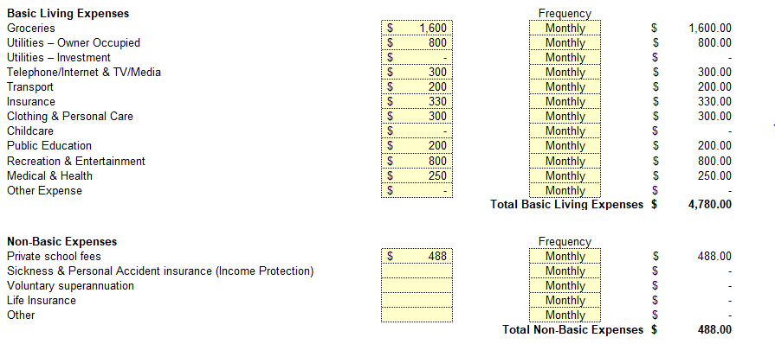
Scenario Expenses

